Slide 1


PIZZA SALE ANALYSIS
BY SQL

Slide 2

About Project
Pizza sales analysis is a crucial aspect for understanding the performance and trends in the pizza business.By using SQL for database creation and data analysis, businesses can gain deep insights and increase overall performance of business. This project focuses on building a comprehensive database using SQL and importing data from various CSV files to perform a thorough analysis of pizza sales.

Slide 3
CREATING DATABASE
Firstly we have to create Database and name it as PIZZAHUT.
Importing CSV files using Table Data Import Wizard option and load Pizzas and Pizza_Types CSV as Two different tables in Database PIZZAHUT.

Slide 4
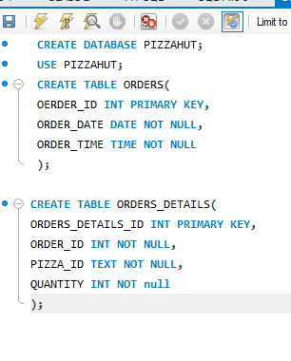
Orders and Orders_Details have multiple rows and Order_date, order_time columns in Text format. To overcome from this problem we first create tables in PIZZAHUT Database, than import values of CSV file in Existing table with correct format.

Slide 5
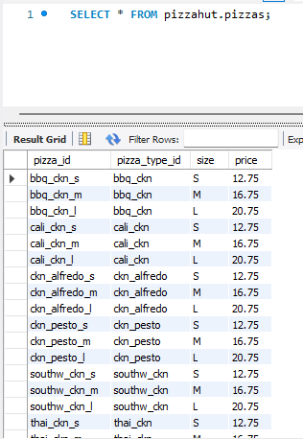
TABLES:
Pizzas:
In Pizzas CSV file we have information about Pizza_id, Pizza_type_id, Size, Price as shown in the picture.

Slide 6
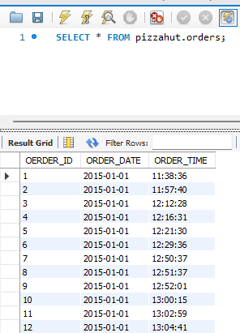
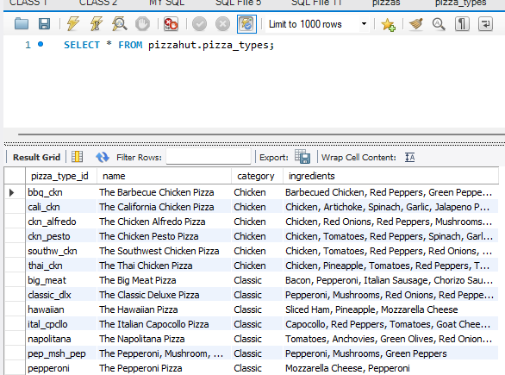
Pizza_Types:
Orders:
In this CSV file we have columns such as pizza_type_id, name, category, ingredients.
Orders CSV have ORDER_ID, ORDER_DATE, ORDER_TIME.

Slide 7
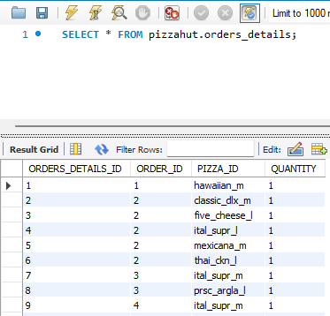
Orders_details:
This CSV file provide information about ORDERS_DETAILS_ID, ORDER_ID, PIZZA_ID, QUANTITY.

Slide 8
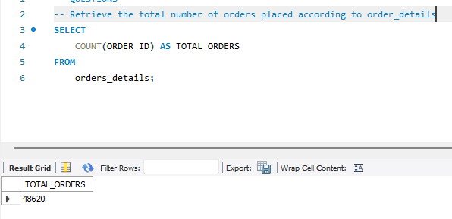
Analysis:
Retrieve the total number of orders placed according to order_details.
The total number of oders 48620. We can say that customer behaviour towards PIZZAHUT is quite good. with this information we can do sale performance, product analysis and many more insights we can genrate.

Slide 9
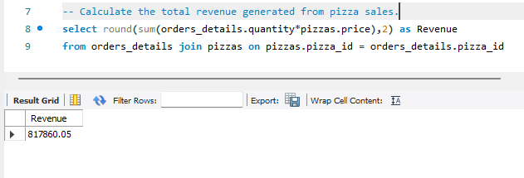
Calculate the total revenue generated from pizza sales.
The total Revenue is 817860.05. To find the revenue we join Pizzas and order
_details pizza_id and use round and sum of order_details.quantity *pizzas.price

Slide 10
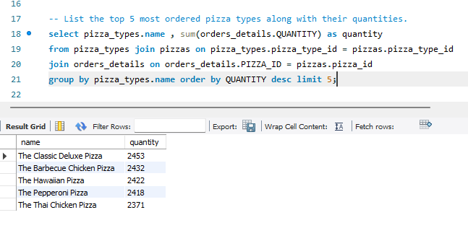
List the top 5 most ordered pizza types along with their quantities.
According to analysis these are the top 5 selling pizzas. We can increase there supply and make them highlight of Pizzahut or we can make combos of them, to attract more customers.

Slide 11
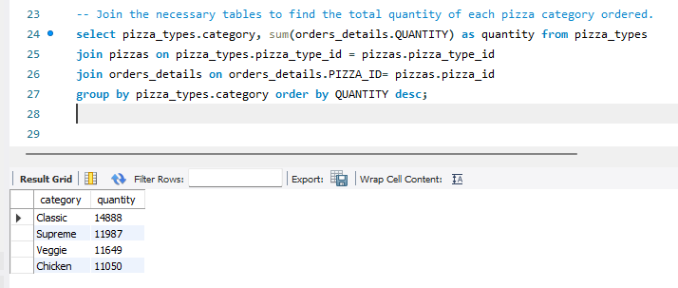
Join the necessary tables to find the total quantity of each pizza category ordered.
The most ordered and popular category are classic, supreme, veggie and chiken.

Slide 12
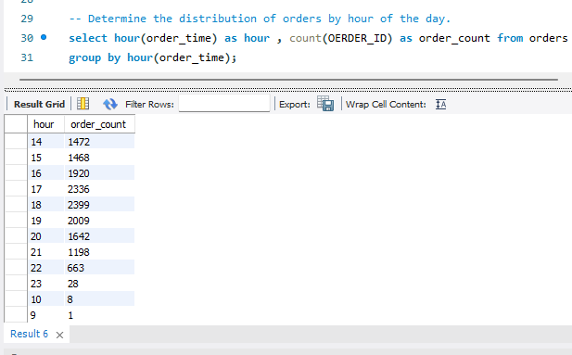
Determine the distribution of orders by hour of the day.
Within 14 hour Pizzahut has highest order count with is 1472 and lowest at 9 hour.

Slide 13
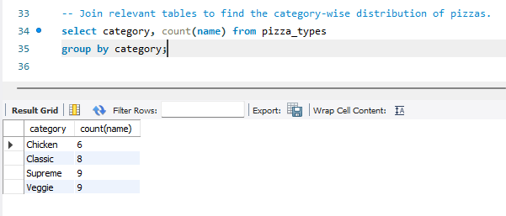
Join relevant tables to find the category-wise distribution of pizzas.
Chicken category has lowest count of 6 and veggies have largest amount of count 9.

Slide 14
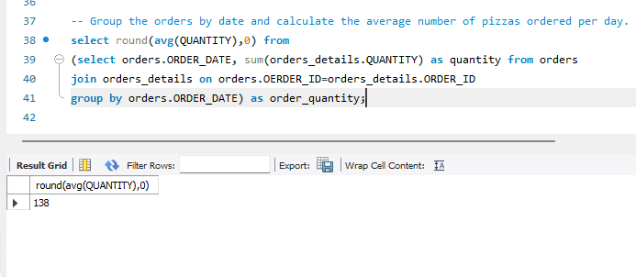
Group the orders by date and calculate the average number of pizzas ordered per day.
By using orders.order_DATE and orders_details.Quantity we find the average of pizzas order per day is 138.

Slide 15
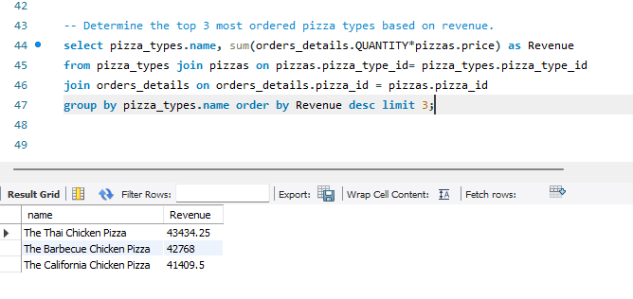
Determine the top 3 most ordered pizza types based on revenue.
Top 3 pizzas that generates revenue more than 41000+ are The Thai Chicken Pizza, The Barbecue Chicken Pizza, The California Chicken Pizza.

Slide 16
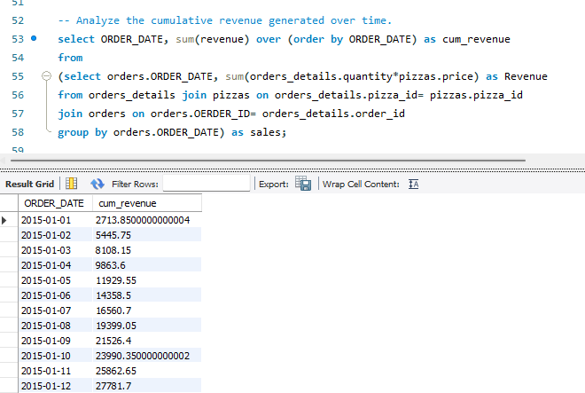
Analyze the cumulative revenue generated over time.
We can calculate cum_revenue from order_Date 1/1/2015. We find cum_revenue by using pizzas, orders, orders_details tables.

Slide 17
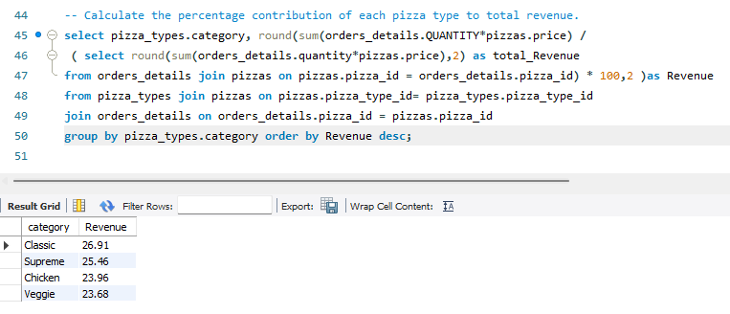
Calculate the percentage contribution of each pizza type to total revenue.
We calculate percentage by (sum of revenue/ Total revenue)*100. Classic category pizza contributes most 26.91 and veggie contributes only23.68 in total revenue.

